Slide 1


Slide 2
AGENDA
WHAT IS DYNAMODB
CREATE DYNAMODB
DYNAMODB CLI COMMANDS
SUPPORTIVE DOCUMENT

Slide 3
WHAT IS DYNAMODB
What is DynamoDB:
DynamoDB fully managed cloud NoSQL database that supports both document and key value store models. Amazon touts DynamoDB as the most popular Cloud based NOSQL database. DynamoDB is NoSQL database not a traditional relational database thus does not support Joins.
Below are a few more key characteristics of DyanmoDB:
DynamoDB Characteristics
Fully Managed NoSQL Database
Key-value pair NoDSQL Database
Durable across 3 availability zones
Hardware is a performance play with dedicated SSD
Scales up or down without any down time
Heavy support for JSON

Slide 4
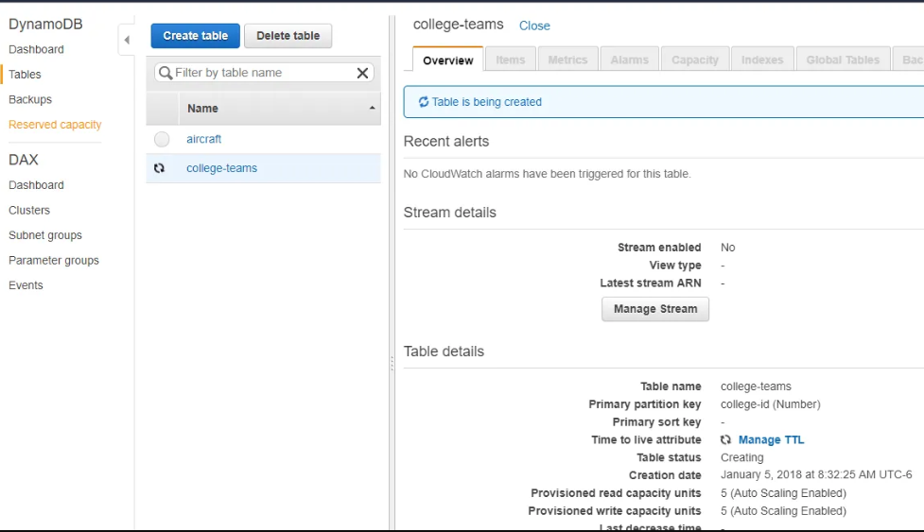
ARCHITECTURE – TRADITIONAL DWH

Slide 5
DYNAMODB CLI COMMANDS
Create ec2 Amazon linux
sudo su –
aws configure
Console – user name (Shivaji) – My security Credentials – access key
Access key, Secret access key, Region, format
[root@ip-172-31-14-212 ~]# aws configure
AWS Access Key ID [None]: V4A6A
AWS Secret Access Key [None]: PmDFyCn3BUIP3F75
Default region name [None]: ap-south-1
Default output format [None]: json or text

Slide 6
DYNAMODB CLI COMMANDS
Create a Table
aws dynamodb create-table --table-name MusicCollection --attribute-definitions AttributeName=Artist,AttributeType=S AttributeName=SongTitle,AttributeType=S --key-schema AttributeName=Artist,KeyType=HASH AttributeName=SongTitle,KeyType=RANGE --provisioned-throughput ReadCapacityUnits=5,WriteCapacityUnits=5
Scan a Table
aws dynamodb scan – Returns one or more items from DynamoDB table. Different from query because scan is a brute force query. Since scan will walk the entire table make sure to use sparingly.
aws dynamodb scan --table-name MusicCollection
Describe Table
aws dynamodb describe-table – Explains from an AWS perspective the table structure.
aws dynamodb describe-table --table-name MusicCollection
List Tables
aws dynamodb list-tables – List all tables in region.
aws dynamodb list-tables
Delete Table
aws dynamodb delete-table – Deletes table and all configurations associated including indexes.
aws dynamodb delete-table --table-name Customer

Slide 7
DYNAMODB CLI COMMANDS
Put Item
aws dynamodb put-item – Add new items or update existing item to DynamoDB table. Using JSON helps add better structure for parameters and allows developer/administrators to not have type all on one line
Get Item
aws dynamodb get-item – Return item with the passed in key value from DynamoDB table. To pass in the values to return it is best to pass in through JSON file. In the example below we want to return the value with a college-id = 1. The “N” specifies the data type which in this example is a number.
Query
aws dynamodb query – Query returns one or more items based of primary keys. Supports any tables or secondary index from composite key. Use JSON to ease query input.
Batch Get Item
aws dynamodb batch-get-item – Query multiple items from DynamoDB Table. They key to using the command is to pass the request to use keys in the JSON file. Used primary for large queries with upper limitation of 100. DynamoDB places an upper limit of 100 on batch-get-item. Make sure to take in to account the capacity read units for each query.
Batch Write Item
aws dynamodb batch-write-item – Allows for administrators/developers to add or delete multiple items in a DynamoDB table. Just like the Batch Get Item the request is passed in the JSON file. For adding items we will use the “PutRequest” and for deleting items use the “Delete-Item”.

Slide 8
SUPPORTIVE DOCUMENT

Slide 9
THANK YOU

